Slide 1
Cross-Linguistic Analysis for Depression Detection
Author: Dinică Mircea

Slide 2
Depression
Disinterest in routine activities
Sleep Disturbances
Inability to feel pleasure
Thoughts of suicide
Affecting over 300 million individuals worldwide

Slide 3
Proposed prevention method
AI model that can be included in applications
Input: text
Output: is depression or not
Applicable for any language

Slide 4
Training Details
Dataset with 7650 entries
LIWC-22 processing tool
Random Forrest Classifier
Classification Metrics, Confusion Matrix, AUC, Feature Importance

Slide 5
Linguistic Inquiry and Word Count
Categorizes words in different psychological states and grammar parts
Uses a dictionary that contains the category as key and the words as values
Translated for multiple languages
Easy to use

Slide 6
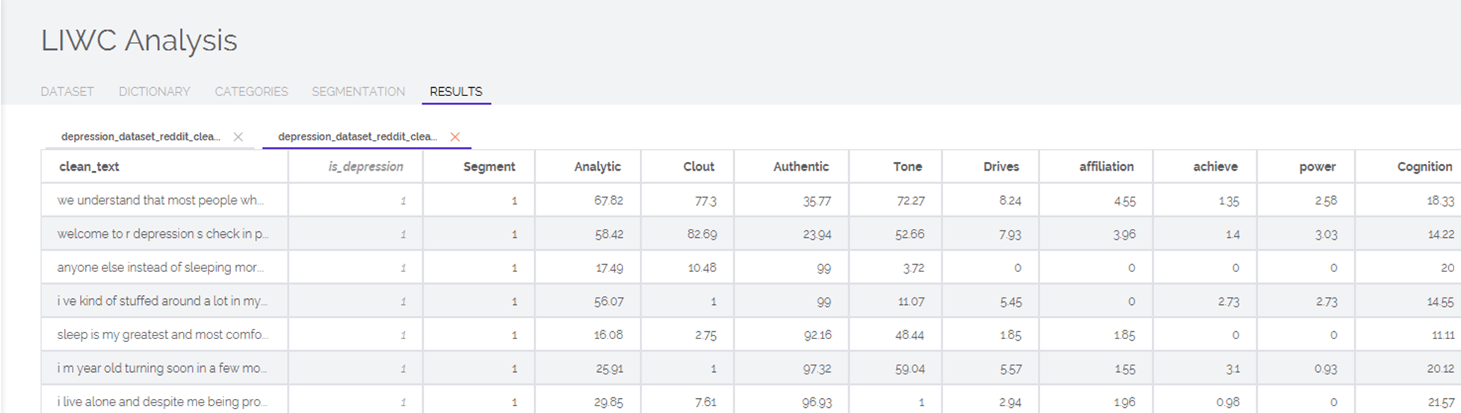
Output
Contains selected metrics and their respective number of words found

Slide 7
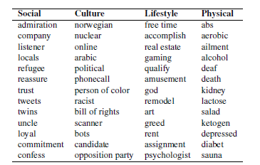
LIWC dictionary categories examples

Slide 8
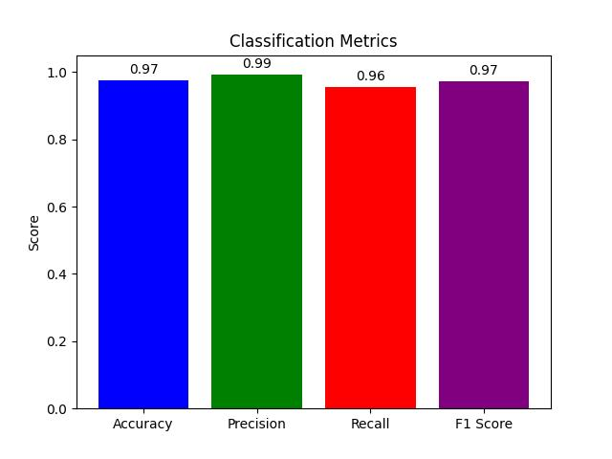
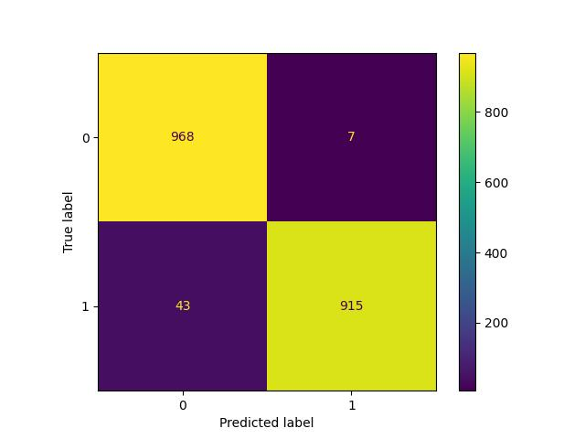
Performance achieved in English

Slide 9
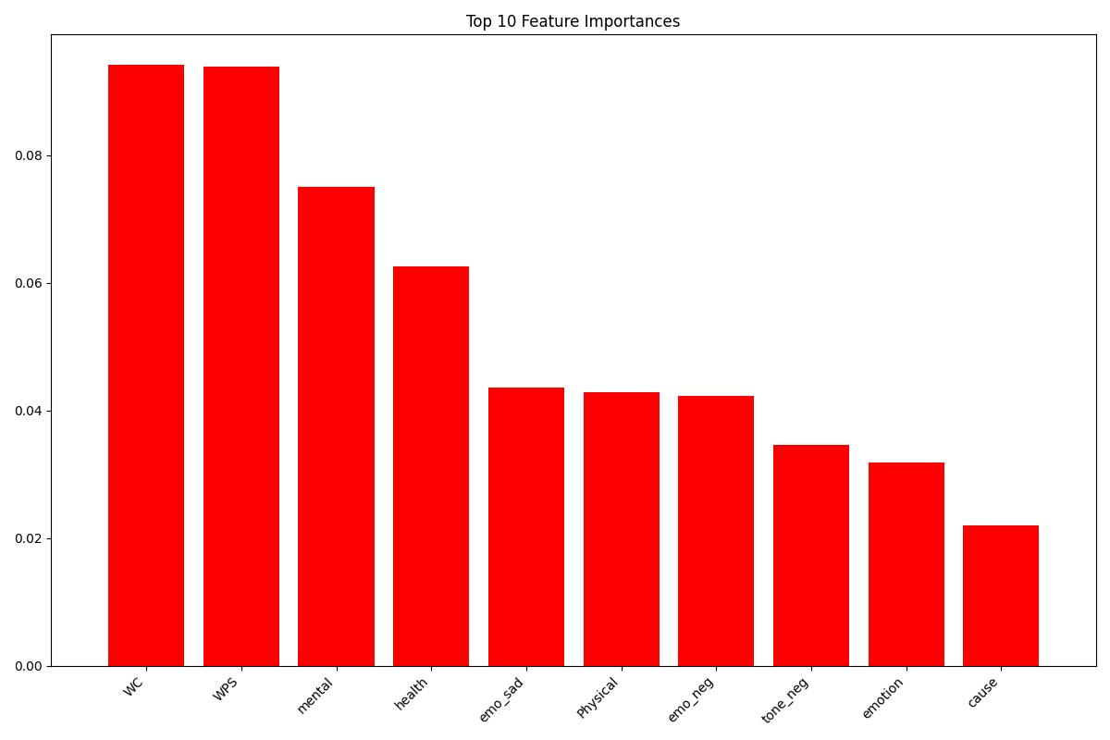
Performance achieved in English

Slide 10
Model for Romanian language
Dataset translated with Googletrans Python Library
LIWC-15 processing tool
Random Forrest Classifier
Classification Metrics, Confusion Matrix, AUC, Feature Importance

Slide 11
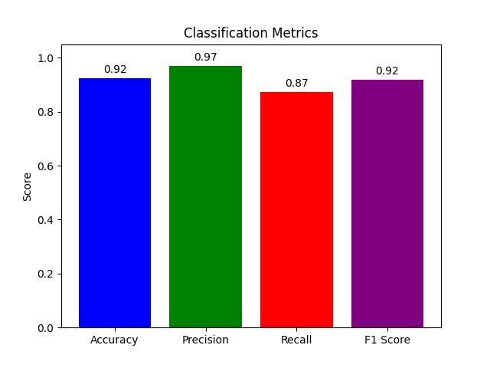
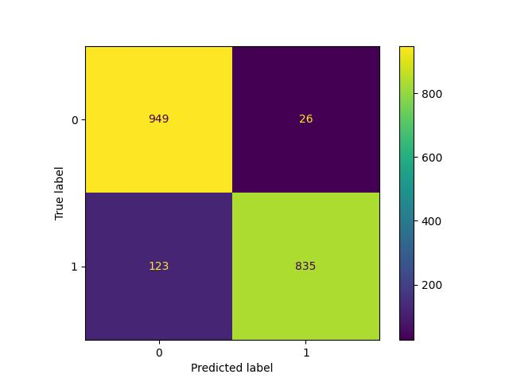
Performance achieved in Romanian

Slide 12
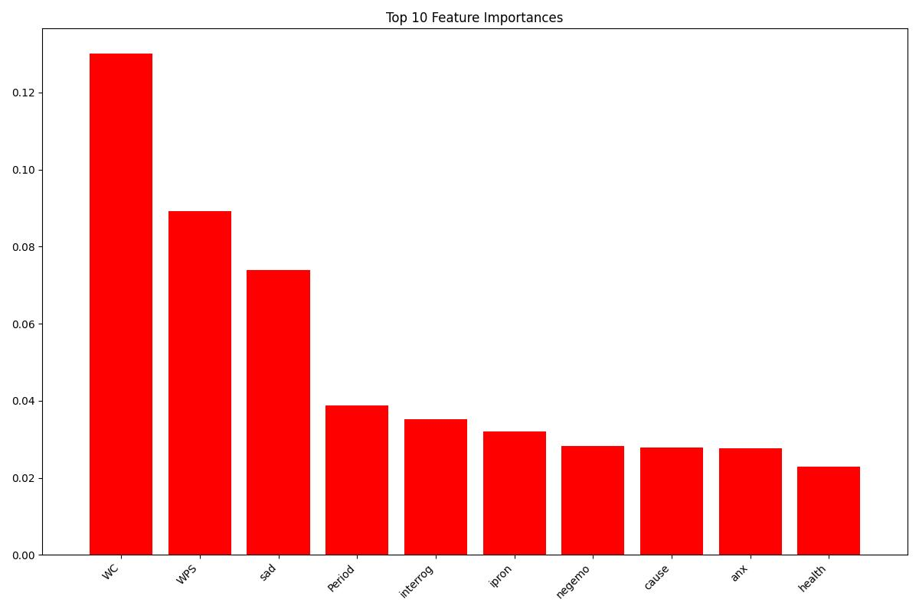
Performance achieved in Romanian

Slide 13
Weaknesses
Highly dependenant on input word count
Problems in identifying positives
Poorer performance in Romanian due to decrease in LIWC version and machine translation method
LIWC can only be used in academic purposes

Slide 14
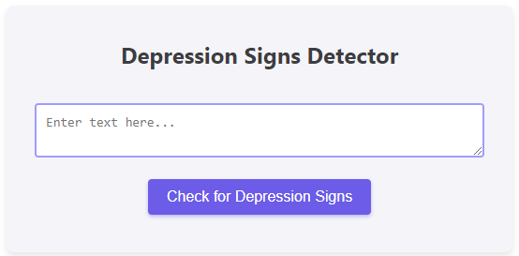
Chrome Extension for Detecting Depression
Easily accessible from where the user wants to analyze the possible text indicative of depression
Multiple languages supported

Slide 15
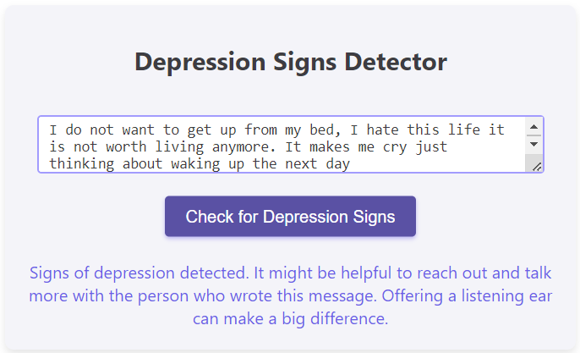
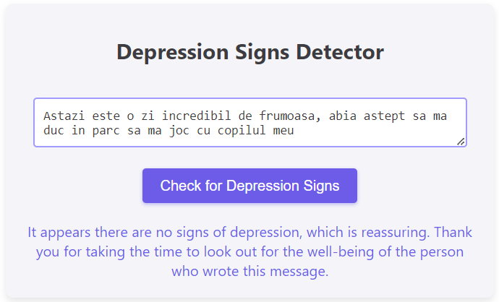
Output
Messages shown for depression or no depression found

Slide 16
Thank you for you attention!
Any questions?

